Slide 1
Cloud Computing Basics
(Very brief highlights)
Shenandoah Valley Governor’s School
Fall 2021
John York

Slide 2
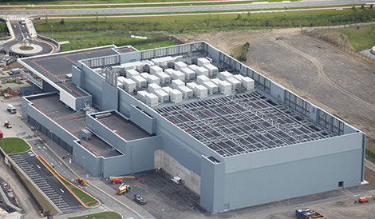
What is “The Cloud?”
Vendors provide computing and related resources for a fee
Started with the development of Hypervisors and Virtual Machines (VMs)
Many cloud vendors are large, with data centers spread over the world
Some provided services are:
Servers or virtual machines
Storage
Networking
Databases
Web sites

Slide 3
Types of Service--Vocabulary
Infrastructure as a Service (IaaS)
Vendor provides basic services
Most basic, most work for customer, most customer control
Examples: Amazon Web Services (AWS), Microsoft Azure, Google Cloud Platform (GCP), Akamai, …
Platform as a Service (PaaS)
Vendor provides running servers for web, database, functions
Middle ground for both work and control
Software as a Service (SaaS)
Practically everything you access from the web
Canvas, GoToMeeting, Salesforce, Blackboard, Medical Information Systems, Google Docs, One Drive, …

Slide 4
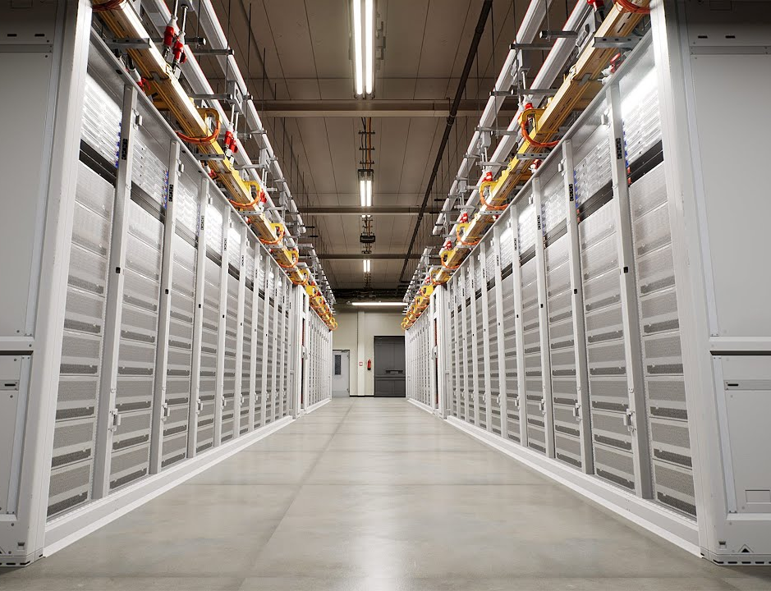
Advantages
Cloud providers tend to be huge
Large scale brings down cost (still not cheap)
Data centers are spread across country or globe
Highly redundant systems
Rapidly scale up and down to meet demand
Pay for services used, no fixed costs

Slide 5
Disadvantages
Control
Your data is on someone else’s machines
Lose some of control of data
Security
Cloud security requires knowledge and practice
Many recent breaches are due to improperly configured cloud systems
Evaluating security of a cloud provider may be difficult
“Lock-in”
Especially with SaaS, migrating data to new provider is difficult
May force customer to stay with provider they aren’t pleased with
Expense

Slide 6
Other concerns
State and federal governments may require that their data is only stored in that state/country
European Union has stringent privacy and security standards related to data storage
Units of a company may bypass IT security by using cloud services on their own
Company is exposed to unknown IT security risk
Smaller units may not use cloud resources securely
Anyone (or any department) with a credit card can use cloud services

Slide 7
Infrastructure as Code
In the cloud, everything you access is virtual
Everything is controlled with software/code.
Web GUI is useful for very small installations (our labs, for example)
Practical installations controlled by command line tools from cloud providers
Want to spin up another VM? Run some commands and scripts
Want to add networking? Run some commands and scripts
If you want to work in the cloud, you need to code

Slide 8
Almost all the basics we will learn apply to the cloud
Installing a cloud VM is very similar to installing one on your laptop
Cloud VMs run the same OS we will work with
Usually, a flavor of Linux
Networking—cloud still has IP subnets, routers and firewalls
Networking fundamentals are still the same
Crypto—cloud uses the same crypto as everyone else
New—cloud and third-party providers develop software tools to create, manage, and monitor cloud installations.

Slide 9
Further Study
Please read one or two of these items
Basics of Cloud Computing
https://www.us-cert.gov/sites/default/files/publications/CloudComputingHuthCebula.pdf
What is Cloud Computing?
https://aws.amazon.com/what-is-cloud-computing/
https://azure.microsoft.com/en-us/overview/what-is-cloud-computing/
https://cloud.google.com/what-is-cloud-computing/
Cloud Security Breaches
https://www.lacework.com/blog/top-cloud-breaches-2019/ https://securityintelligence.com/six-major-data-breach-trends-from-2017/
See paragraph three

